Slide 1



WINDOWS VS LINUX

Slide 2
CONTENTS
WHAT IS OPERATING SYSTEM?
DIFFERENT TYPES OF OPERATING SYSTEMS.
WINDOWS OS
VERSIONS
FEATURES OF WINDOWS OS
LINUX OS
FEATURES OF LINUX OS
VERSIONS
COMPARISON
CONCLUSION

Slide 3
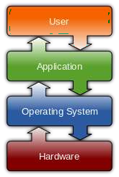
WHAT IS AN OPERATING SYSTEM?
An operating system is software that manages computer hardware and software resources and provides common services for computer programs.
The operating system is an essential component of the system software in a computer system. Application programs usually require an operating system to function.
Eg. Manager

Slide 4







History
Unix
Mac
Linux
Solaris
Debium
Redhat
Slackware
DOS
MS DOS
WINDOWS

Slide 5





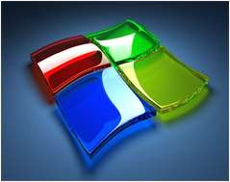



Mostly using Systems
Operating
Mac OS by Apple
Windows by Microsoft Corp.
Linux by Community

Slide 6
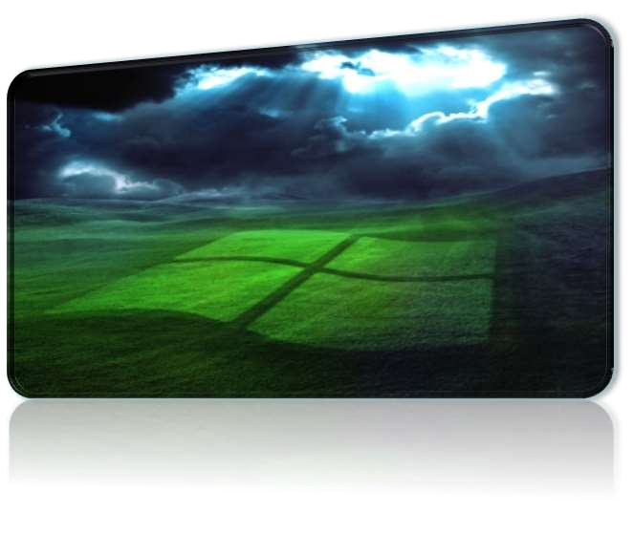
WINDOWS OS
Microsoft Windows operating system was developed by Microsoft to overcome the limitation of its own MS- DOS operating system.
First successful version were Windows
3.0, released in 1990.
Subsequently released version were “Windows 95, Windows 98, Windows 2000, Windows XP, Windows XP Professional , Windows Vista, Windows 7, Windows 8, Windows 8.1 and nowadays Microsoft launches it’s latest OS Windows 10.”

Slide 7
VERSIONS OF WINDOWS
Windows 10
Windows 8
Windows 7 Windows vista Windows XP Windows 2000
Windows 98
Windows 95 Windows NT Windows 1.0

Slide 8
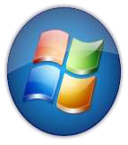
Features of Windows OS
Easy to use -> Microsoft windows is easy to use as compared to other OS most popular OS in the world.
Performance monitor -> Alt+Ctlr+Del
Files management -> It manage your files automatically into a spefic location.
Based on MS-Dos -> Windows is a MS-DOS based operating system.

Slide 9


What is Linux?
Linux is a free Unix-type operating system originally created by Linus Torvalds developed under the General Public License and the source code of which is freely available to every one.
LINUX kernel created by Finnish college student, Linus Torvalds in 1991.
LINUS TORVALDS

Slide 10
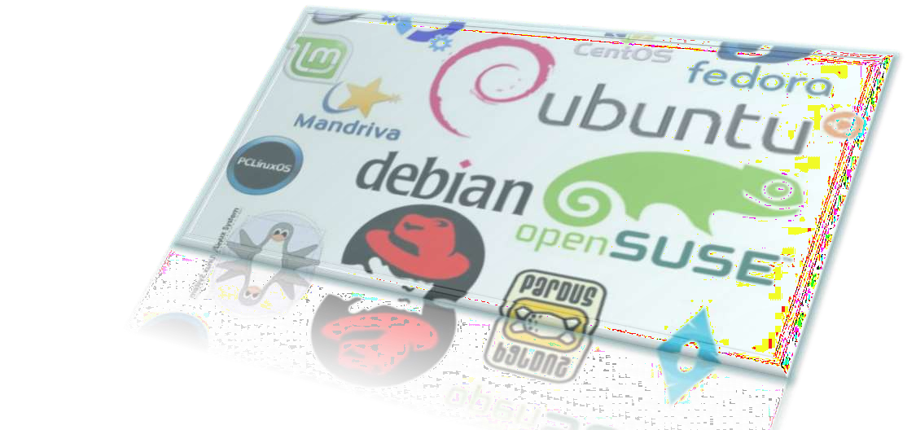
VERSIONS OF LINUX
REDHAT FEDORA UBANTU DEBIAN KNOPPIX
SUSE SLACKWARE

Slide 11

Features of Linux os
Open Source Operating System -> Any programmer can modify it due to it’s needs.
Free Software -> Linux is a free software any one can download
it from web and install it on it’s pc
It runs on a wide range of hardware from PCs to Macs -> Many pc user can install linux to it’s system there is no specific requirements for installing it.

Slide 12
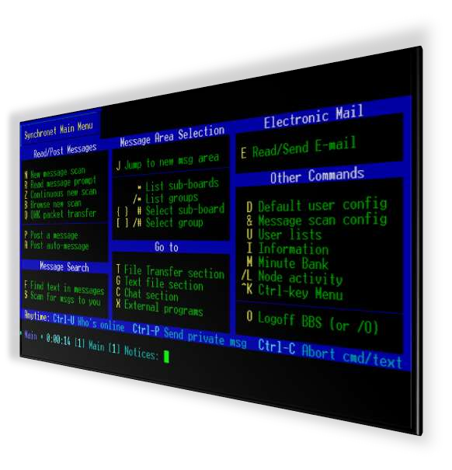
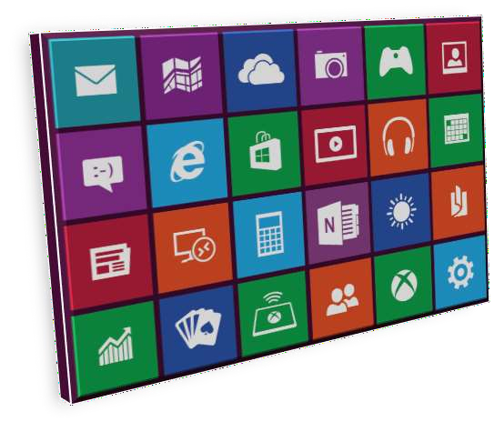
COMPARISION
GUI & CUI
Windows OS
Linux OS

Slide 13





COMPARISION
Security & Price
Windows OS
Linux OS
THERE ARE MANY TYPES OF VIRUSES IN WINDOWS OS BECAUSE OF A LARGE AMOUNT OF MARKET SHARE
WINDOWS IS EXPENSIVE
THERE ARE LESSER AMOUNT OF VIRUSES IN LINUX AS COMPARED TO WINDOWS BECAUSE LINUX IS AN OPEN SOURCE OS
LINUX SOFTWARE IS TOTALLY FREE

Slide 14

COMPARISION
Compatibility & Reliability
Windows OS Linux OS
ANYONE CAN INSTALL ANY TYPE OF GAME INTO WINDOWS PC WINDOWS PC IS COMPATIBLE OF ALL TYPE OF SOFTWARES AND GAMES
WINDOWS IS RELIABLE BUT DUE TO VIRUSES IT STRUCKS
LINUX IS A OPEN SOURCE SOFTWARE SO YOU CAN PROGRAM THE SOFTWARES THAT YOU WANT
LINUX IS NOT A COMPLETE OS YOU CAN MODIFY IT FOR THAT TYPE OF USAGE THAT YOU WANT

Slide 15

COMPARISION
Bundled Software
Windows OS
Linux OS
BY DEFAULT HAS VERY MINIMAL SOFTWARE SET.
THE BASIC FEATURES – WORD PROCESSOR, SPREAD SHEET AND A PRESENTATION SOFTWARE ARE NOT PRESENT.
NEED TO PURCHASE AND INSTALL THE MS OFFICE SUITE SEPARATELY.
LINUX COMES WITH THE LIBRE OFFICE SUITE (A MICROSOFT OFFICE EQUIVALENT) PREINSTALLED.
IT ALSO HAS F-SPOT AND AN INSTANT MESSAGING CLIENT CALLED EMPATHY -CHAT FOR FACEBOOK, MSN & VOIP CAPABILITIES ALL UNDER A SINGLE APPLICATION

Slide 16
Comparision
Windows OS
Linux OS
No Full Access on OS
Licensing Restrictions
No Command Line
Explicitly we need to Install Drivers
Flat File Systems
Threat detection is slow & fixing
patches takes 2 to 3 months
Paid help desk support
Paid Software's Eg. Ms Office
Full Access on OS
Licensing Freedom
Command Line
Inbuilt Drivers
Hierarchal file system
Threat detection & clearing threats
is very fast
Online peer support
Free Software's Eg. Libre office

Slide 17
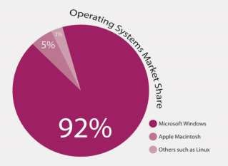
Market Share
 | Windows | Linux
Estimated Desktop Usage Share | 84.07% (w3counter) | 1.71% (w3counter)
Server market share | 73.9% (officially registered) | 21.2% (officially registered)
Top 500supercomputer operating system | 1.0% (absolute 5) | 91.0% (absolute 455), the 14 fastest supercomputers run Linux
family share

Slide 18
Conclusion
In conclusion, no operating system is really better, the choice is up to you. If you're a gamer, then you have no choice, go for Windows. Programmers might prefer Linux and video/graphics producers will probably tend towards Mac. The best thing to do is probably to try each OS and see which is best for you!

Slide 19

THANK YOU
Bhargav

